Slide 1

Introducing accessEQ
FOR ENHANCED AUDIO
ON THE MAC

Slide 2
accessEQ Background
80% of hearing aid demos are returned by dissatisfied users, why?
Speech intelligibility is not improved

Slide 3
accessEQ Background
Signal-to-Noise ratio (SNR) determines
speech intelligibility, simple gain (amplification) does not improve SNR
The hearing aids processor is computationally weak compared to the Mac’s processor
Can the Mac processor be used to improve
speech intellibility of Mac audio in real-time?
A: accessEQ

Slide 4
Downloading & Installing accessEQ
Download the free accessEQ 2024A release (1.2.1.0) from Github @
https://github.com/TCupolo/accessEQ/releases/download/1.2.1.0/accessEQ.app.zip
Unzip accessEQ.app.zip to accessEQ.app
Move accessEQ.app over to the standard Mac Applications folder
Double click accessEQ.app to run it

Slide 5
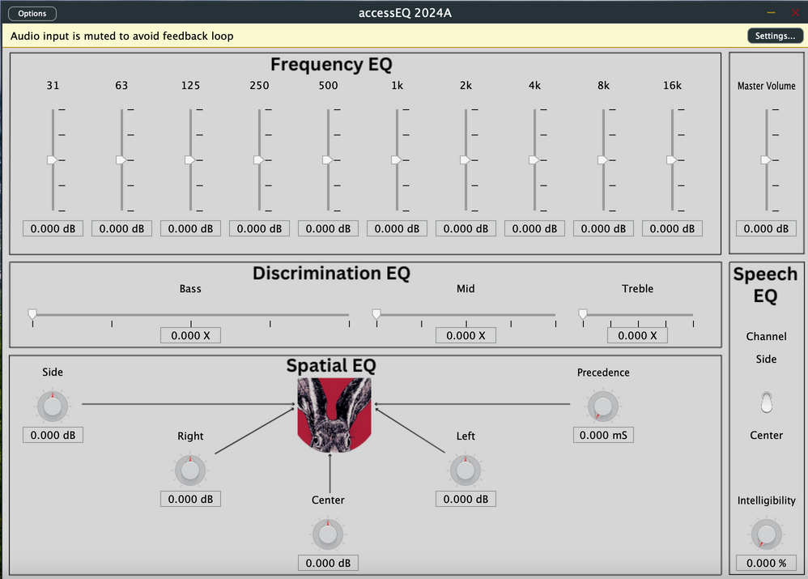
accessEQ App
accessEQ is like a software hearing aid when run as an app. It uses the Mac’s built-in microphone.
Also, the very 1st time its run, it registers as an AUv3 plugin with macOS.
NOTE: to confirm plugin registration was successful, run auval -a in the terminal, a complete list of installed plugins is returned.

Slide 6
accessEQ Plugin
Even when accessEQ is not being run as an app, it can still function as a plugin with 3rd party hosting apps. There are 2 types of hosting apps.
SWAC: System Wide Audio Capture
Enables accessEQ to process all Mac audio real-time
The primary use case
DAW: Digital Audio Workstation
Enables accessEQ to process recorded audio
A secondary use case

Slide 7


SWAC Hosting App Options
SoundSource by Rogue Amoeba
Has been around for over 10 years
Has worked with accessEQ for 3+ years
Regular updates for bug fixes/new features
Free 14 day trial then paid
https://rogueamoeba.com/soundsource/
eqMAC by Roman Kisil
Has been around for about 2 years
Has worked with accessEQ for 1+ year
Free Basic version, paid Pro version
https://eqMAC.app
NOTE: Both of these apps must be downloaded from the above sites. Around 2022, as an enhanced security measure, Apple decided to make installing any app downloaded outside the Mac App Store intentionally difficult. As a result, the installation process for both of these apps now requires some manual intervention. This consists of changing security settings (which you will be prompted for) and rebooting the Mac before the installation can complete.

Slide 8
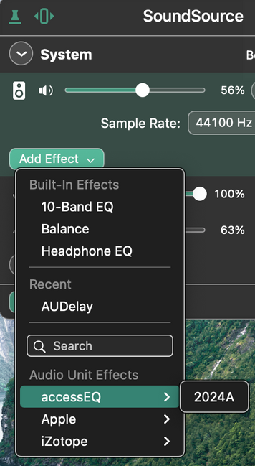
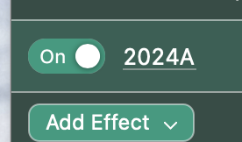
Using accessEQ with SoundSource
Run SoundSource
Click Add Effect
Select accessEQ
Select 2024A
Enable 2024A

Slide 9
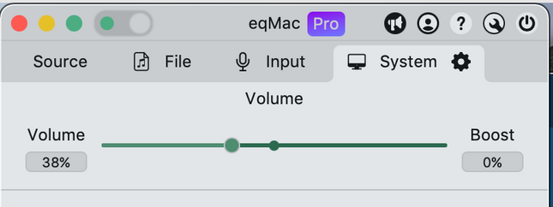
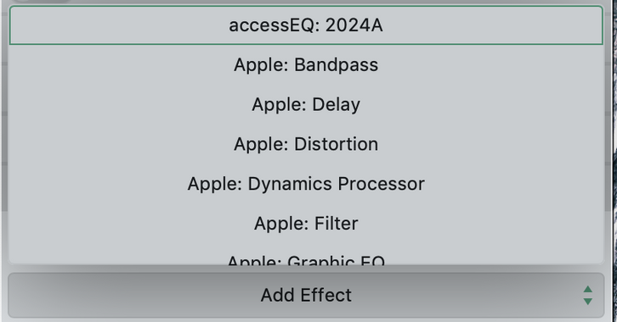
Using accessEQ with eqMAC
Run eqMAC
Click Add Effect
Select accessEQ: 2024A

Slide 10

Using accessEQ with eqMAC
Enable accessEQ: 2024A

Slide 11


DAW Hosting App Options
Audacity by The Audacity Team
Has worked with accessEQ for 3+ years
Free
https://www.audacityteam.org/
GarageBand by Apple
Has worked with accessEQ for 3+ years
Free
Download from the Mac App Store
NOTE: AUv2 plugins were known to occasionally cause DAWs to “hang” and there was no easy way to exit this condition other than to reboot. So, Apple came out with the AUv3 format mostly to improve DAW users experience with plugins. AUv3 plugins (like accessEQ) can now be killed independently of the DAW process. This is simply accomplished by running “Force Quit” (under the Apple icon on the menu bar at the top) on the plugin.

Slide 12
EFFECTS
accessEQ provides 5 different types of EQ, all for the purpose of enhancing audio, and specifically to improve speech intelligibility.

Slide 13
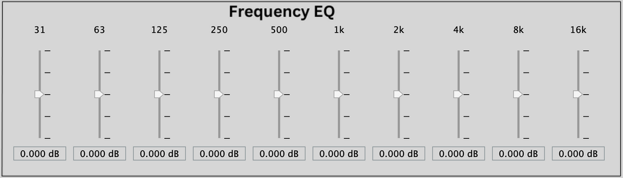
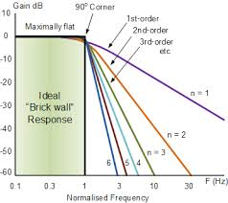
Frequency EQ
The human hearing spectrum spans from 20hz to 20Khz, which accessEQ divides into 10 octaves, with center frequencies:
accessEQ uses 6th order filters to ensure the spectral purity of each octave. The graph to the right shows how they compare to other filter orders, which in turn reveals their practical equivalence to brick wall performance.

Slide 14
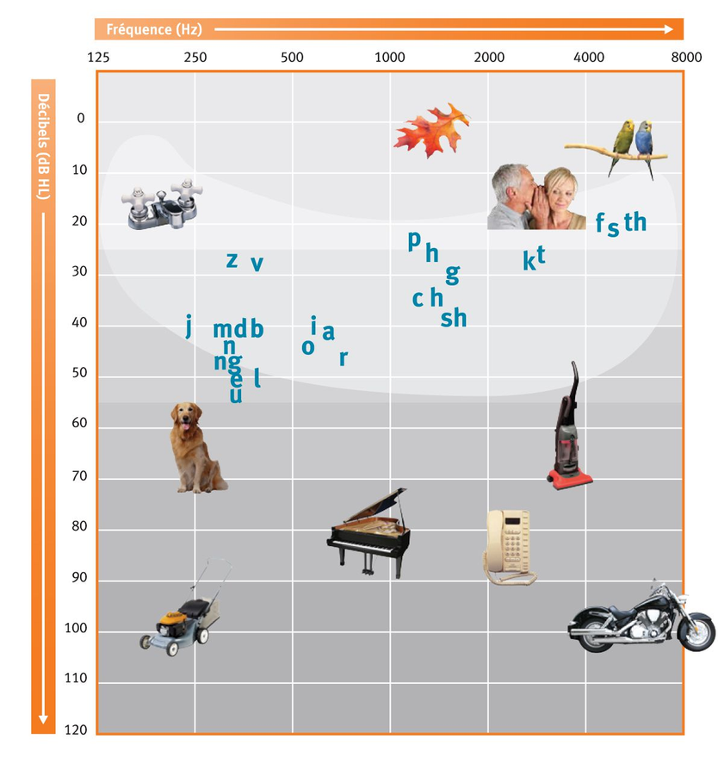
Frequency EQ
As a reference, the graph to the right shows how the so- called “speech banana” and other common sounds span the human hearing spectrum as a function of signal amplitude.

Slide 15
Discrimination EQ
One of the advantages of using accessEQ is it’s inclusion of new effects related to frequency resolution metrics. They determine the SNR required for speech intelligibility. There are 3 key frequency resolution metrics:
Frequency Discrimination:
Determines how far apart in frequency 2 different sinusoids, separated in time, must be to be perceived (as melodies).
Frequency Selectivity:
Determines how far apart in frequency 2 different sinusoids, present simultaneously, must be to be perceived (as chords).
Frequency Tuning:
Determines how far apart in amplitude 2 different sinusoids, present simultaneously, must be to be perceived (as a properly tuned instrument).

Slide 16
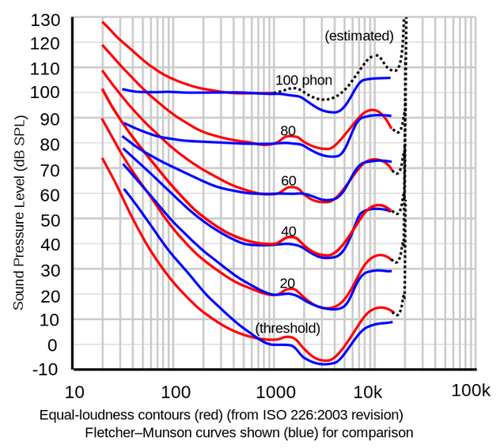
Discrimination EQ
Fletcher and Munson were the first auditory researchers to investigate how loud the human ear perceives different frequencies at the same amplitude. They published their results as a set of equal loudness contours. Later researchers published a more accurate set of measurments as the ISO 226-2003 standard, shown to the right.

Slide 17
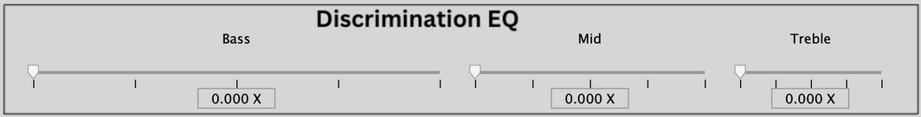
Discrimination EQ
accessEQ converts these equal loudness contours into an equivalent single filter specification. The filter is partitioned into 3 bands as follows:
Each discrimination filters covers the following frequency band:
Bass: 20Hz - 750Hz
Mid: 750Hz - 6000Hz
Treble: 6000Hz - 20000Hz
Testing has determined discrimination is typically most improved with the following settings:
Bass: 0.15 - 0.25
Mid: 0.50 - 0.65
Treble: 0.20 - 0.50

Slide 18
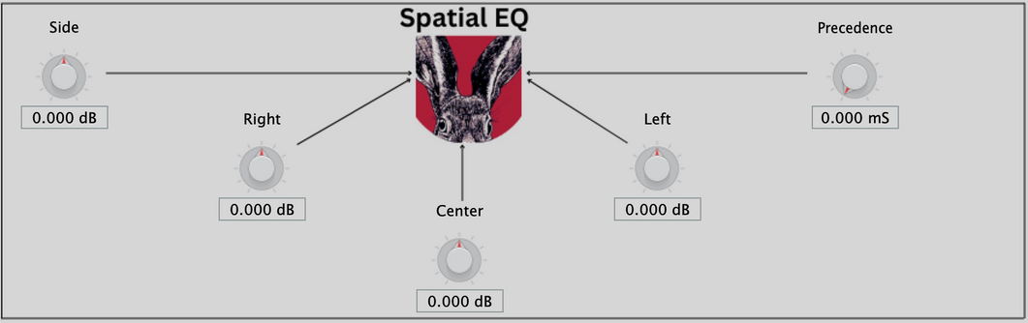
Spatial EQ
Sound can also be viewed as a field, something that arrives from various directions. Most commonly, audio is delivered as a stereo signal which consists of a left and a right channel. Simple math allows these to be converted into center and side channels. accessEQ provides independent gain controls for all 4 channels, which are displayed intuitively as follows:
NOTE: The Precedence effect allows some delay to be introduced between the center and side channels. This can be used to add more of a “live” feel to both recorded audio and video soundtracks.

Slide 19
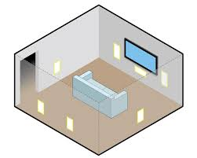

Spatial EQ
Older music was recorded with vocals in the center and instruments on the side. This was intended to replicate live performance setups as shown below. However, this tended to “mask” the instrument tracks, which can now be brought back out by applying side gain.
In home theater and vehicle settings, spatial EQ likewise allows for compensating out changes in the spatial signal balance due to distributed speaker placements:

Slide 20
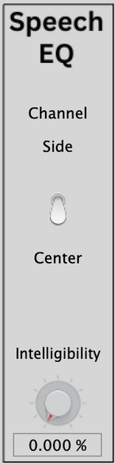
Speech EQ
SNR is a function of:
Signal amplitude
Noise from frequency components
Noise from spatial components
Reduced frequency resolution due to mixing multiple audio sources at different loudness levels
For these reasons, accessEQ provides a single control, shown to the right, that “overrides” all effects settings to simplify improving speech intelligibilty real-time. The user only needs to select the desired speech channel (center or side).
Works great on web calls!

Slide 21
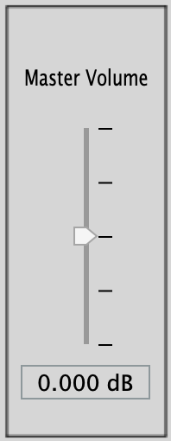
Loudness EQ
accessEQ was built for the purpose of enhancing audio quality at the SAME volume. After all the previous effects are applied, the new “wet” signal volume changes. Therefore, a Master Volume control is provided to allow users to adjust the wet volume back to the dry volume level. In this way, the master volume really should be considered a Loudness EQ effect.
NOTE: All the hosting apps provide a master “enable/disable” control for plugins. Toggling it, while adjusting the Master Volume, is a simple way to match the wet & dry volume after all other effects have been set.

Slide 22
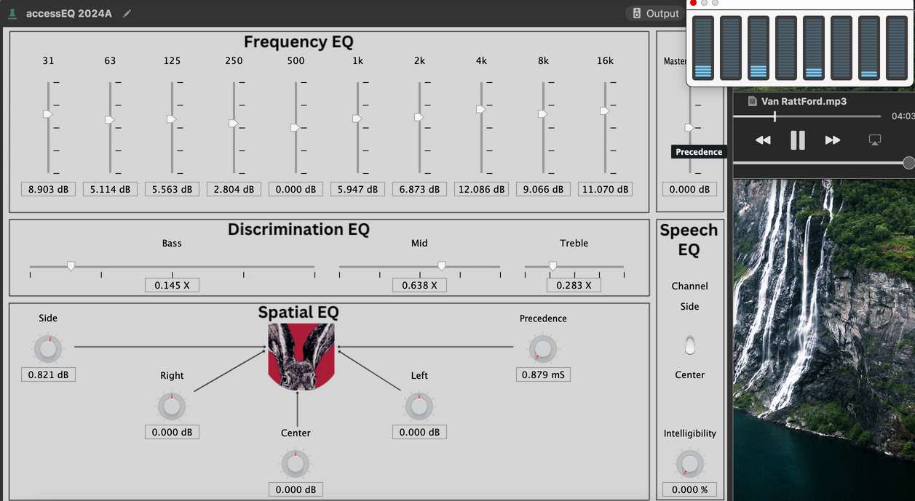
Mac Processor Loading
Despite all the audio signal processing accessEQ performs real-time, when run from a SWAC hosting app there is minimal impact on the Mac’s processor loading. The screen capture below shows the Mac’s real-time Acitivity Monitor CPU (Quad-Core) Usage bar graph display. SoundSource is hosting accessEQ which is processing the audio QuickTime is playing.

Slide 23
accessEQ Open Source Motivation
50% for better user support
As the user base grows, it will quickly become to much for one person (me) to support
Finding the right effect settings can be challenging
Particularly for non-technical users
50% for broader platform deployment
iOS/Android/Windows
See the Fork Wishlist for details

Slide 24
Support Plan
End Users
I’ll create Youtube videos and share them on my YouTube channel:
https://www.youtube.com/@RaidioTony
I’ll create an AI chatbot assistant trained on accessEQ, it could be integrated with an accessEQ host app (see the Fork Wishlist).
Developers
My LinkedIn account is publicly open to developers to connect with me for technical Q&A:
https://www.linkedin.com/in/tonycupolo/
I’ll add technical content to the accessEQ Github Wiki
https://github.com/TCupolo/accessEQ/wiki

Slide 25
Branch Roadmap
Branch here means features I plan on implementing in future Github releases. Matlab releases come out bi-annually, most contain new audio features. accessEQ releases will follow the same schedule.
Branch Relase | Feature | Description
2024B | Compression | A tri-band compressor that will raise accessEQ status to a full software hearing aid. Matlab already has support for compresion but the UI is too complicated given accessEQ’s other features. So, this release is pending the release of an enhanced plugin UI feature from Matlab. I have submitted a request for such an improvement to Matlab.
2025A | Selectivity EQ | The second frequency resolution feature that will further improve speech intelligibility.
2025B | Tuning EQ | The third frequency resolution feature that will further improve speech intelligibility.
2026A | Speech Extraction | AI can already extract speech from any background but not yet in real-time.

Slide 26
Fork Wishlist
Fork here means features I hope others will implement in future Github releases.
Fork | Feature | Description
macOS | Audio Server Driver Based SWAC Host | Apple only allows SWAC hosting apps into the Mac App store if they use this method. (SoundSource and eqMAC do not.) Getting an integrated accessEQ SWAC host/plugin app into the Mac App store would be a big adoption driver, particularly if it’s free. An integrated AI chatbot assistant would be a great addtional feature.
iOS | AudioBus Host / iOS App Extensions | Apple doesn’t offer any SWAC type framework on iOS due to their app sandbox policy. However, Audiobus is a highly adopted 3rd party API that allows apps to voluntarily exchange audio data real-time. This opens the door to the possibility of an Audiobus based integrated accessEQ host/plugin app. However, App Extensions for the core Apple iOS apps would also have to be developed to support sharing their audio data with accessEQ over Audiobus.
Windows | SWAC Host | Converting accessEQ to the PC compatible VST plugin format is trivial. However, I don’t know of any SWAC hosting apps for the PC. Further, the Windows audio engine is well known to suffer from large audio latency.

